Slide 1

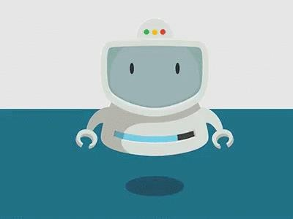
Artificial Intelligence
Chapter 2: Intelligent Agents
Instructor: Anaum Hamid

Slide 2


Agents and environments
Rationality
PEAS (Performance measure, Environment, Actuators, Sensors)
Environment types
Agent types
❑

Slide 3

Certainly not these…

Slide 4
Agents
An agent is anything that can be viewed as perceiving its environment through sensors and acting upon that environment through actuators.

Slide 5


AGENTS
Agent
Environment
Percepts
Sensors
?
Acts
Actuators

Slide 6
Agents
Human agent: Eyes, ears, and other organs for sensors; hands, legs, mouth, and other body parts for actuators
Robotic agent: Cameras and infrared range finders for sensors; various motors for actuators.
Software agent: Software agent is a computer program that acts for a user or other program: an agreement to act on one's behalf.

Slide 7
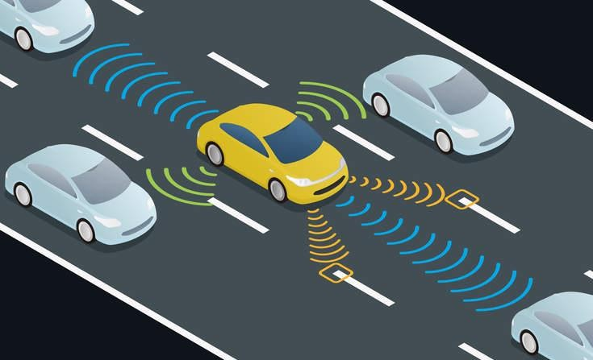
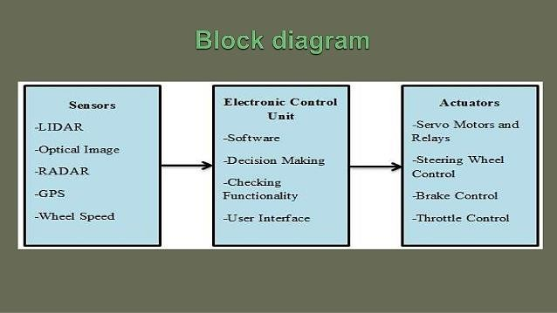
Robotic Agent

Slide 8
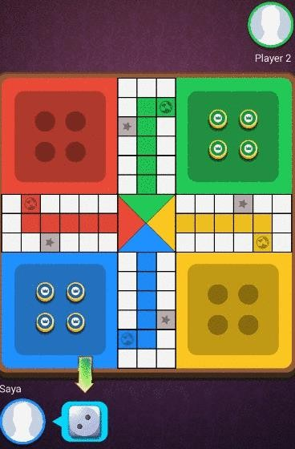
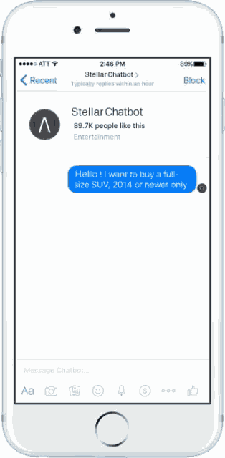
Software Agent

Slide 9
Percept Sequence
Agent
Environment
percept refers to the agent’s perceptual inputs at any given instant.
An agent’s percept sequence is the complete history of everything the agent has ever perceived.
Sensors
Percepts
?
Acts
Actuators

Slide 10
Agent Function
Agent
Environment
An agent’s behavior is
described by the agent function Agent Function that maps any given percept sequence to an action.
Sensors
Percepts
?
Acts
Actuators

Slide 11
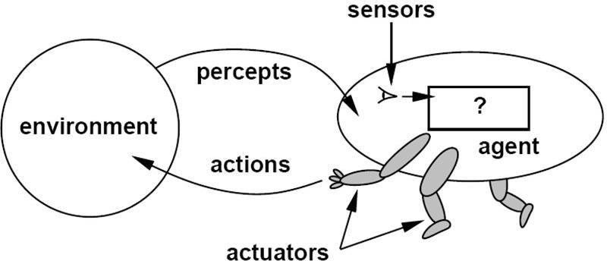

Agents and Environments
environment
The agent function maps from percept histories to actions:
[f: P* → A]
The agent program runs on the physical architecture to
produce f
Agent = Architecture + Program

Slide 12
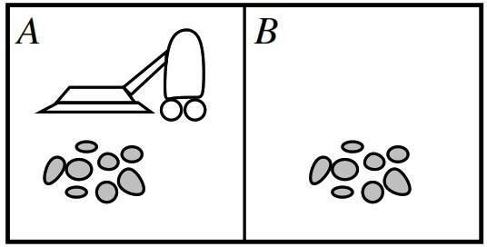

Vacuum-cleaner world
Percepts: location and contents, e.g., [A, Dirt]
Actions: Left, Right, Suck, Do Nothing

Slide 13

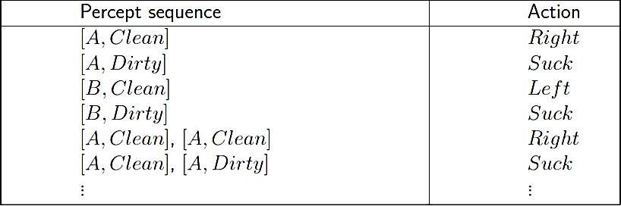
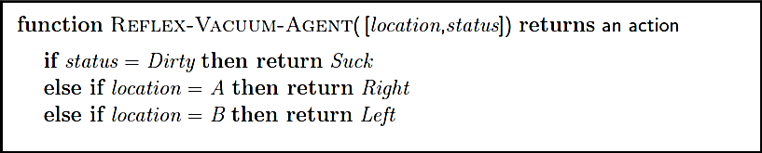
A vacuum-cleaner Agent
Tabulation of an agent function of the vacuum-cleaner
8

Slide 14

Intelligent Agents
Agents and environments
Rationality
PEAS (Performance measure, Environment, Actuators, Sensors)
Environment types
Agent types
❑
8

Slide 15
Rational Agents
An agent should strive to "do the right thing", based on what it can perceive and the actions it can perform. The right action is the one that will cause the agent to be most successful.
Agent Goals:
High Performance measure (an objective criterion for success of an agent's behavior) e.g. self driving car agent could be Safety
Optimized Result (Decision)e.g. amount of time taken(shortest route, less traffic )
Rational Action ( Right Action) e.g. Speed
9

Slide 16
Rational Agents
Agents can perform actions in order to modify future percepts so as to obtain useful information (information gathering, exploration, learn).
An agent is autonomous if its behavior is determined by its own experience (with ability to learn and adapt).
11

Slide 17
Intelligent Agents
Agents and environments
Rationality
PEAS (Performance measure, Environment, Actuators, Sensors)
Environment types
Agent types
❑

Slide 18
PEAS
When designing a rational/intelligent agent, we keep in mind
PEAS.
PEAS: Performance measure, Environment, Actuators, Sensors
Consider, e.g., the task of designing an automated taxi driver:
Performance measure
Environment
Actuators
Sensors

Slide 19
PEAS
Agent: automated taxi driver
Performance measure: Safe, fast, legal, comfortable trip,
maximize profits
Environment: Roads, other traffic, people and objects in/around the street
Actuators: Steering wheel, accelerator, brake, signal, horn
Sensors: Cameras, sonar, speedometer, GPS, odometer, engine sensors, keyboard

Slide 20
PEAS
Agent: Medical diagnosis system
Performance measure: Healthy patient, minimize costs, lawsuits
Environment: Patient, hospital, staff
Actuators: Screen display (questions, tests, diagnoses, treatments, referrals)
Sensors: Keyboard (entry of symptoms, findings, patient's answers)

Slide 21
PEAS
Agent: Part-picking robot
Performance measure: Percentage of parts in correct bins
Environment: Conveyor belt with parts, bins
Actuators: Jointed arm and hand
Sensors: Camera, joint angle sensors

Slide 22
Intelligent Agents
Agents and environments
Rationality
PEAS (Performance measure, Environment, Actuators, Sensors)
Environment types
Agent types
❑

Slide 23
Environment Types
1) Fully observable vs. 2) Partially observable
Sensors capture all relevant information from the environment
3) Deterministic vs. 4) Stochastic (non- deterministic)
Changes in the environment are predictable
5) Episodic vs. 6) Sequential (non-episodic)
Independent perceiving-acting episodes
7) Static vs. 8) Dynamic
No changes while the agent is “thinking”
9) Discrete vs. 10) Continuous
Limited number of distinct percepts/actions
11) Single vs. 12) Multiple agents
Interaction and collaboration among agents
Competitive, cooperative

Slide 24
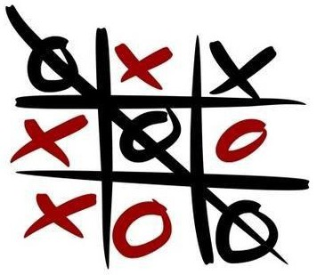

Environment Types
Fully observable (vs. partially observable): An agent's sensors can measure all relevant aspects of the environment at each point in time.
Tic Tac Toe is Fully Observable. Cards are Partially Observable.

Slide 25
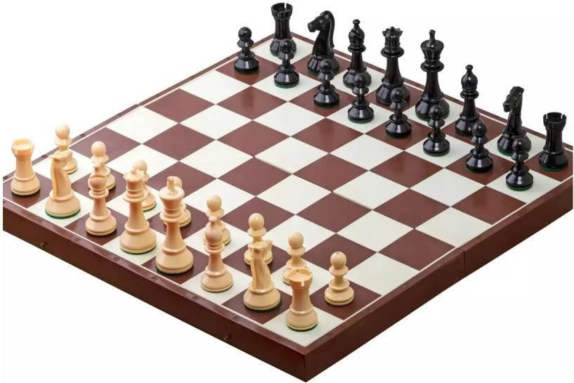
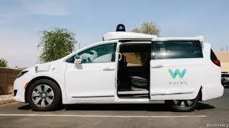
Environment Types
Deterministic (vs. stochastic): The next state of the environment is completely determined by the current state and the action executed by the agent. (Stochastic: next state cannot be predicted with certainity)
Chess is deterministic. Taxi driver is stochastic.

Slide 26
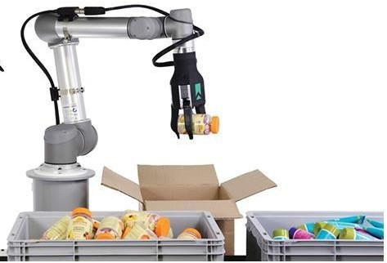
Environment Types
Episodic (vs. sequential): The agent's experience is divided into atomic "episodes" (each episode consists of the agent perceiving and then performing a single action), and the choice of action in each episode depends only on the episode itself.
Robot is Episodic. Taxi driver is sequential.
Notes:
In an episodic environment, the agent's experience is divided into episodes which consist of a percept sequence and an action. Since episodes are independent of one another and the agent doesn't need to know the effect of its actions.

Slide 27
Environment Types
Static (vs. dynamic): The environment is unchanged while an agent is thinking. (The environment is semidynamic if the environment itself does not change with the passage of time but the agent's performance score does).
Taxi driver is dynamic. Chess is static.
Notes:
An environment is dynamic if it changes while an agent is in the process of responding to a percept sequence. It is static if it does not change while the agent is deciding on an action i.e the agent does not to keep in touch with time. An environment is semidynamic if it does not change with timebut he agent's performace score does.
Image analysis system
Chess with a clock

Slide 28
Environment Types
Discrete (vs. continuous): A limited number of distinct, clearly
defined percepts and actions (Defined Rules and Actions).
Chess has a finite number of distinct states. thus it is discrete; however the Taxi-driving is not.

Slide 29
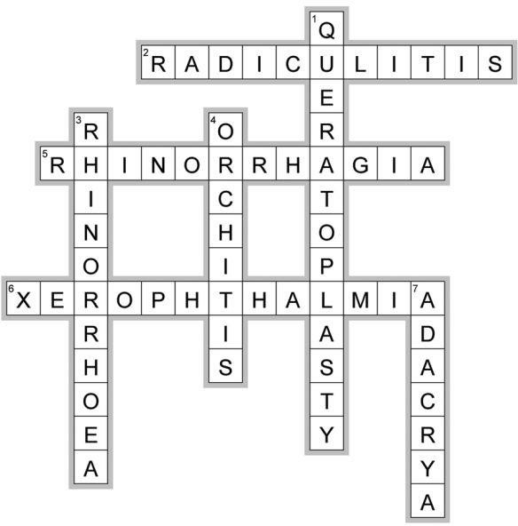
Environment Types
Single agent (vs. multiagent): An agent operating by itself in an environment.
Crossword is Single agent, while Chess is a multi-agent environment.
27

Slide 30
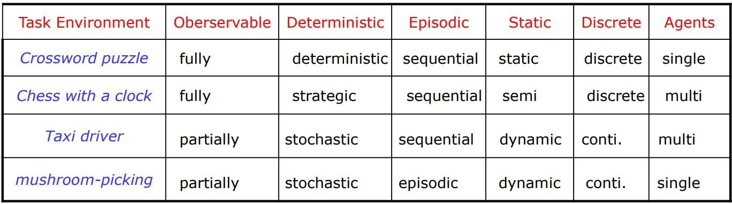
Environment Types
The environment type largely determines the agent design
The real world is (of course) partially observable, stochastic, sequential, dynamic, continuous, multi-agent
https://www.geeksforgeeks.org/types-of-environments-in-ai/

Slide 31
Intelligent Agents
Agents and environments
Rationality
PEAS (Performance measure, Environment, Actuators, Sensors)
Environment types Agent types
❑

Slide 32
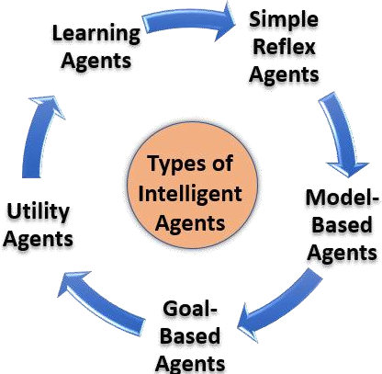
Agent Types
Agents can be divided in to five (05) basic types according to the degree of perceived intelligence and capacity to change the environment:
Simple reflex agents
Model-based reflex agents
Goal-based agents
Utility-based agents
Learning Agents

Slide 33
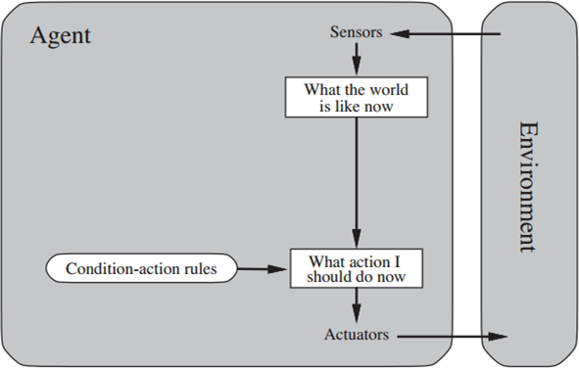
Simple Reflex Agents
The agent selects an action(s) based on the current precept and conditions, ignoring the rest of the precept history (previous state).
if x happens, do y
e.g. Poker

Slide 34
Simple Reflex Agents
Very limited Intelligence
No Knowledge/Perception about the previous or
next state
Operates in Partially Observable Environments Infinite loops are unavoidable
30

Slide 35
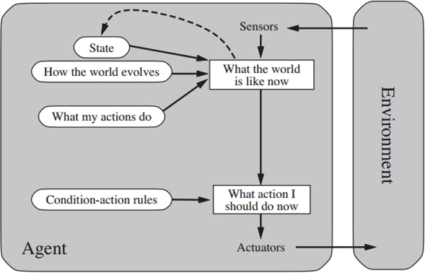
Model-based Reflex Agents
The agent decides its action(s) based on a predefined set of condition-action rules.
Depending on the state of the world, different actions are appropriate.
State is evaluated in terms of how it changed from the previous state.
e.g:A Roomba Cleaner Robot, a telephone operator/answering machine.
31

Slide 36
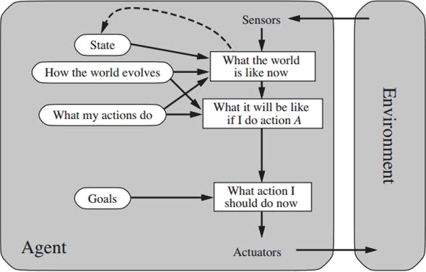
Goal-based Agents
The agent decides its action(s) based on a known goal. These agents have all of the above and goal.
Involves consideration of the previous and future states.
e.g.a GPS system finding a path to certain destination.

Slide 37
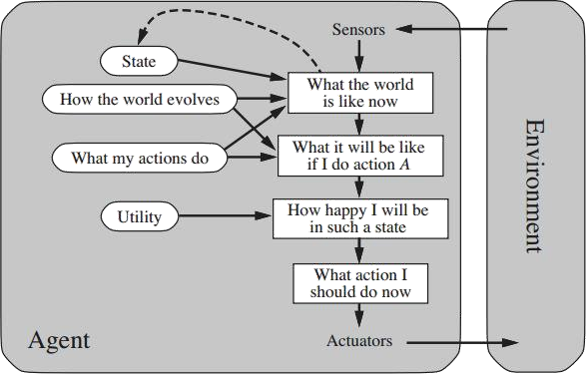
Utility-based Agents
The agent decides its action(s) based on utilities/ preferences.
Utility function to decide which world state (Optimality) is better for an agent
e.g. A GPS
system finding a shortest/fastest/sa fer path to certain
destination.

Slide 38
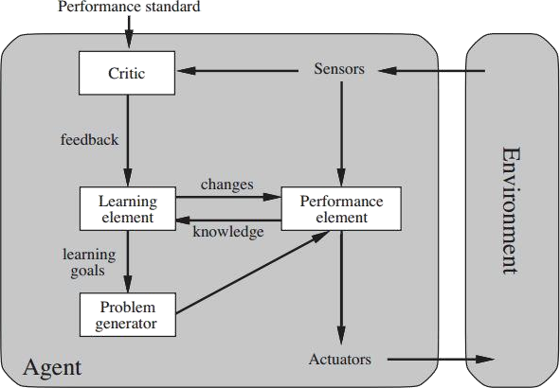
Learning Agents
The agent adapts its action(s) based on feedback (not only sensors).
Learning element - responsible for making improvements from past events.
Performance element - what we have up to now considered to be the
entire agent. Takes percepts and then decides on actions.
Critic - gives the learning element feedback on how the performance element is doing and if it needs to be modified.
Problem generator - it suggests actions that lead to new and
informative experiences.
e.g. human agent

Slide 39
Summary
Intelligent Agents
IA Behavior
IA Structure
Environment types
Agent Types: Reflex, state-based, goal-based, utility-based

